Slide 1
Adoption 101
Heartland for Children’s
Trauma Informed, Relationship Focused Adoption Training
Class Five
Heartland for Children is a community-based care lead agency
contracted with the Department of Children and Families.

Slide 2
Welcome To Adoption 101, Class Five!
Welcome back!
Discussion of last week & homework
Today’s Agenda!
  Guest Speaker
  Pillars of Complex Developmental Trauma
  Empowerment Principles

Slide 3
Three Main Pillars for Healing
Safety – The child IS safe and FEELS safe
Connection/Relationship
Building Coping Skills

Slide 4
Principles of Trust-Based Relational Intervention
The 3 Pillars parallel the 3 evidence based principles of Trust-Based Relational Intervention (TBRI):
  Empowering
  Connection
  Correction
We will discuss elements of each principle, starting with empowerment.

Slide 5
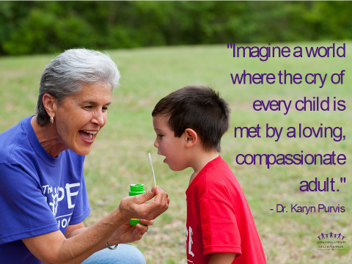
What are empowering principles?
Empowering is connecting by meeting a child’s needs.

Slide 6
Meeting Needs is Critical for Attachment & Felt Safety
Attachment Cycle
  Child has a need > Child Expresses Need > Need Met by Caregiver
    Trust, Attachment, Felt Safety
Let’s not forget what our children’s attachment cycle has historically looked like & their attachment style!
All of the TBRI Principles aim to meet a child’s needs.
Empowerment principles looks at meeting the child’s physical needs, both ecologically and physiologically.

Slide 7
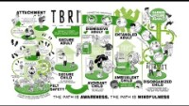
TBRI Animate: Attachment

Slide 8
Physiological Strategies of Meeting Needs
Hydration
  Improves memory, attention, cognition and behaviors.
  Should be drinking every 2 hours!
Nutrition
  Proper nutrition can improve cognitive & emotional functioning
  Whole grains, turkey, fish, nuts, lentils, & Omega-3 fatty acids provide the building blocks for healthy brain chemistry
  Children with histories of substance exposure and early childhood trauma often have significant changes to insulin receptor sites, making them subject to dramatic shifts in behavior when their blood sugar begins to drop below optimal levels.
  Need regular, nutritious snacks every 2 hours! Focus on protein and complex carbohydrates
Healthy Touch
  Touch is our first sense to develop and our skin is our largest organ!
  Touch can actually change brain chemistry and is critical to healthy development
  Remember that some children are fearful of touch - find way to engage in a way that feels safe for the child
Physical Activity
  Physical Activity can regulate brain chemistry by brining down excitatory and stress neurochemicals in the brain and boosting calming neurochemicals.
  If they receive the appropriate levels of physical activity, a child’s learning and memory are enhanced. If they overdo it, they can have a meltdown.
  Every 2 hours they should be involved in a physical activity!
Sleep

Slide 9

Healthy Touch

Slide 10
Physiological Needs Continued
Sensory Processing
  1 out of 20 children have sensory processing difficulties, with a higher than average rate for children who have experienced trauma. It is often undetected, overlooked, or diagnosed as something else.
  Sensory Processing Disorder can be defined as a “practical inability to use information received through the senses so as to function smoothly and normally in everyday life.”
  This can lead to difficulties with eating, getting dressed, riding in a car, playing with others, etc.
  Helpful to pay attention to input they are seeking and what they are avoiding. Journaling is sometimes helpful.

Slide 11

A Sensory World

Slide 12
Physiological Strategies:
Understanding Sensory Processing
Five external senses: sight, smell, touch, taste, and sound
The senses serve four primary functions:
  ALERT the body and brain to important cues
  PROTECT the body and brain from becoming overwhelmed
  SELECT what is important to pay attention to
  ORGANIZE the brain automatically
Three internal or body-centered senses help the brain create meaning from sensory input received from the environment
  Vestibular
  Proprioceptive
  Tactile

Slide 13
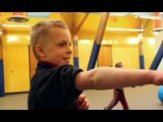
A Child’s View of Sensory Processing

Slide 14
How can we meet our children’s sensory needs?
Weight lifting (proprioceptive, calming, organizing)
Basketball (vestibular, hand-eye coordination)
Swimming (proprioceptive, tactile)
Trampoline (vestibular)
Climbing (proprioceptive, vestibular, hand-eye coordination)
Tight clothing (proprioceptive)
Massage (proprioceptive, tactile)

Slide 15
Empowering Principles, Ecological Strategies
Supporting our children in their environment, and ensuring they are seen, heard, and valued!
Felt Safety
  To have felt safety, must feel connected, that they belong, and are being their true self
Transitions
  Daily Transitions
  Life Transitions
  Prepare them for success!
Scaffolding Self-Regulation
  Help your child learn to self-regulate

Slide 16
More Empowering Strategies
Daily Routine
  Consistent, predictable, and prepares for what is coming next
Rituals
  Routine that builds connection!
Artifacts
  Object with meaning, sentimental

Slide 17


Slide 18
Reflection:
What elements of Mr. White video relates to what we talked about today?
What are some key words for you that has stuck in your mind related to the empowering principles?
After learning this information, where there any “ah ha” moments?
After learning this information, is there anything you may start doing differently in your everyday life?
QUESTIONS?

Slide 19
Thank you!
Homework:
  Empowering Strategies
Handouts:
  The Healing Power of “Giving Voice”
  Dan Hughes’ 24 S’s: A Guide for Raising your Troubled or Sensitive Child
  10 Tips for Stressed Out Parents
  Your 8 Senses
  Sensory Profiles
  Weighted Items: Tools for Helping Children Learn to Regulate

